Slide 1



TEAM - 5
Recommending Study Habits Based on Student Behavior
Team Members
Srija Ilam
Miryala Nandu Vasanthi
Mentor –Mr. Krushnaraj

Slide 2

INTRODUCTION
The "Recommending Study Habits Based on Student Behavior" project is a cutting-edge data science solution designed to personalize learning and improve academic performance.
By analyzing student behavioral data, such as time spent on tasks, quiz scores, and attention logs, the system provides users with insights into their unique learning patterns.
This intelligent and user-friendly application empowers students to make informed decisions about their study routines, while also enabling educators to provide targeted support based on data.
•The "Recommending Study Habits Based on Student Behavior" project is a cutting-edge data science solution designed to personalize learning and improve academic performance.

Slide 3


PROJECT OVERVIEW
Student Features
01
Log in and create a profile to access the application.
02
Log study habits, including duration, methods, and distractions.
03
Receive weekly recommendations for personalized study routines.
04
View a dashboard to track performance and progress over time.
05
Provide feedback on recommendations to improve the system's accuracy.

Slide 4
PROJECT OVERVIEW
Administrator Features
01
Log in to access the administrator dashboard.
02
Upload new student datasets to the system.
03
View performance data and feedback logs in a comprehensive dashboard
04
Trigger the retraining of the machine learning modelS.
05
Manage user accounts and system settings..

Slide 5



MILESTONE
01
Basic Authentication and Dashboard Setup
Set up the project environment using Django and MySQL.
Developed user registration and login pages for authentication.
Created a simple user dashboard to display basic user information.
Established the backend database connections for storing user details securely.
02
Admin Dashboard and Enhanced Functionality
Developed an admin dashboard to manage all registered users on the platform.
Added features to edit and delete student accounts directly from the admin panel.
Integrated student progress tracking to display overall performance metrics.

Slide 6
MILESTONE
03
Personalized User Dashboard Implementation
Designed a personalized dashboard for each logged-in user.
Displayed individual study tracks, courses, and durations fetched from the admin database.
Ensured data privacy and secure access so users view only their own progress.
Delivered a customized learning experience tailored to each learner’s profile.
04
Smart Notifications and AI-Based Course Recommendations
Implemented automated email notifications sent at scheduled intervals (morning, afternoon, evening) based on course completion percentage.
Added quiz reminders to encourage users to attempt pending assessments.
Integrated dashboard alerts highlighting courses with over 75% completion but not yet finished.
Used AI integration to analyze user progress and recommend courses for continued learning.

Slide 7


Technology Stack
Frontend:
HTML, CSS
IDE:
VS Code
Database:
MySQL
Backend:
Django, Python

Slide 8
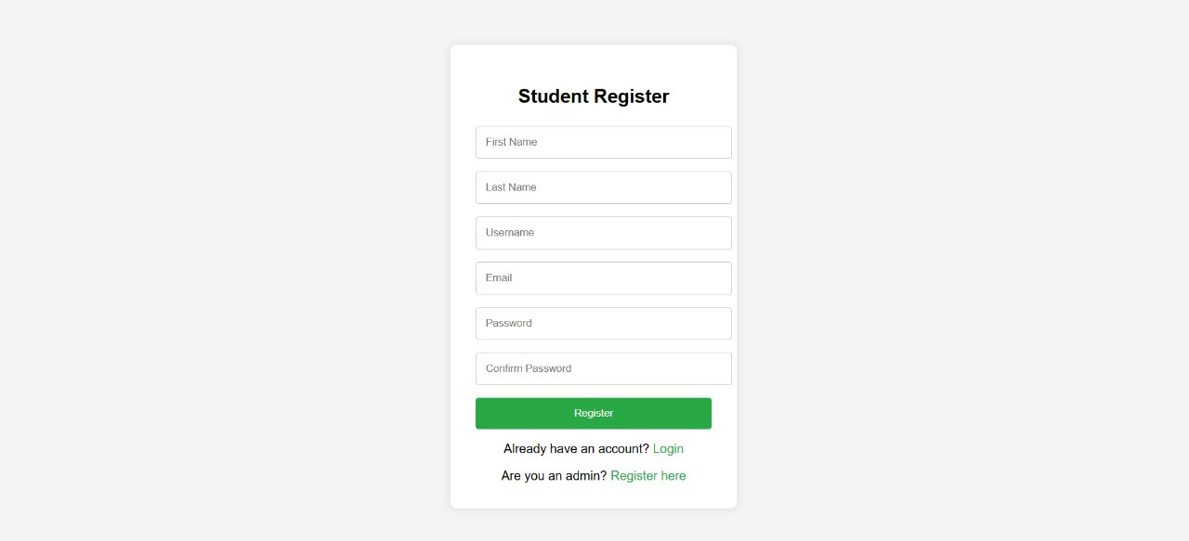
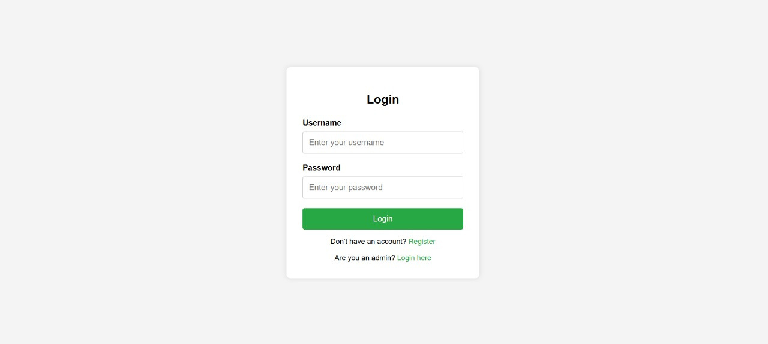
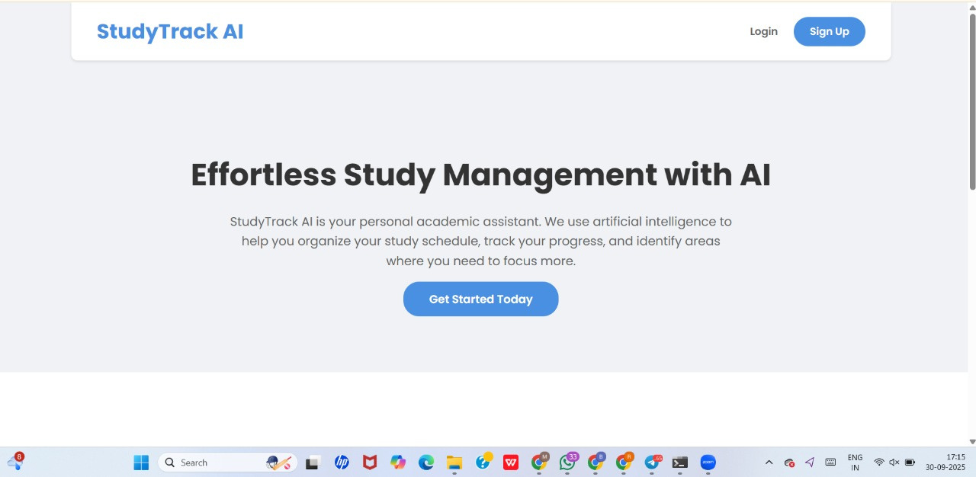

Login page
Register page
Home Page

Slide 9

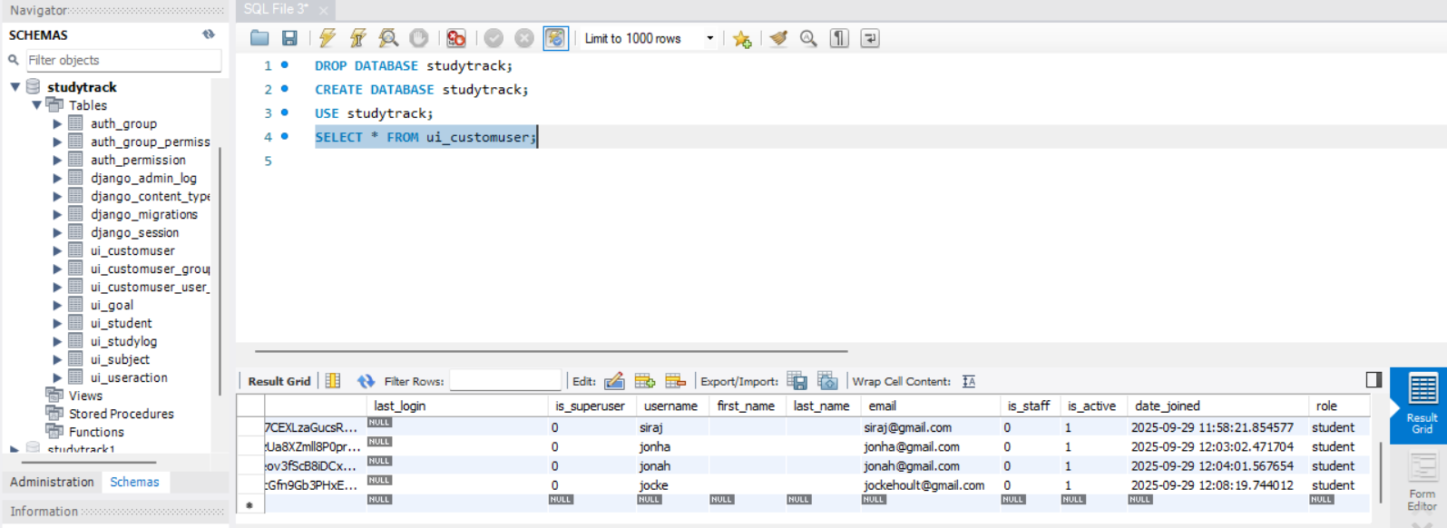

DATABASE

Slide 10
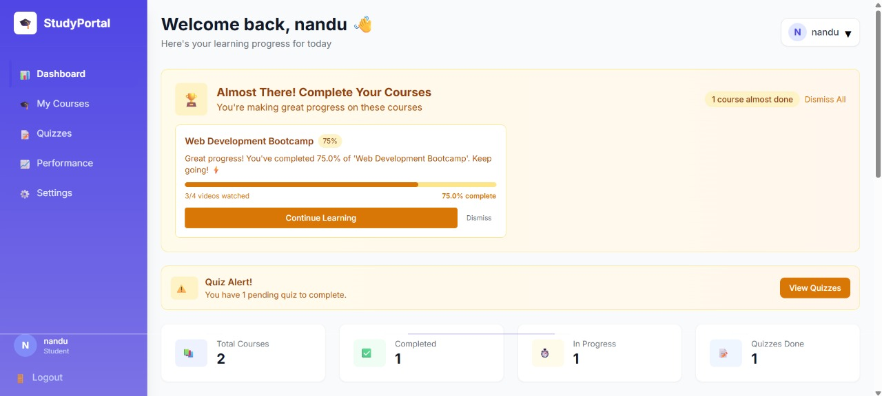
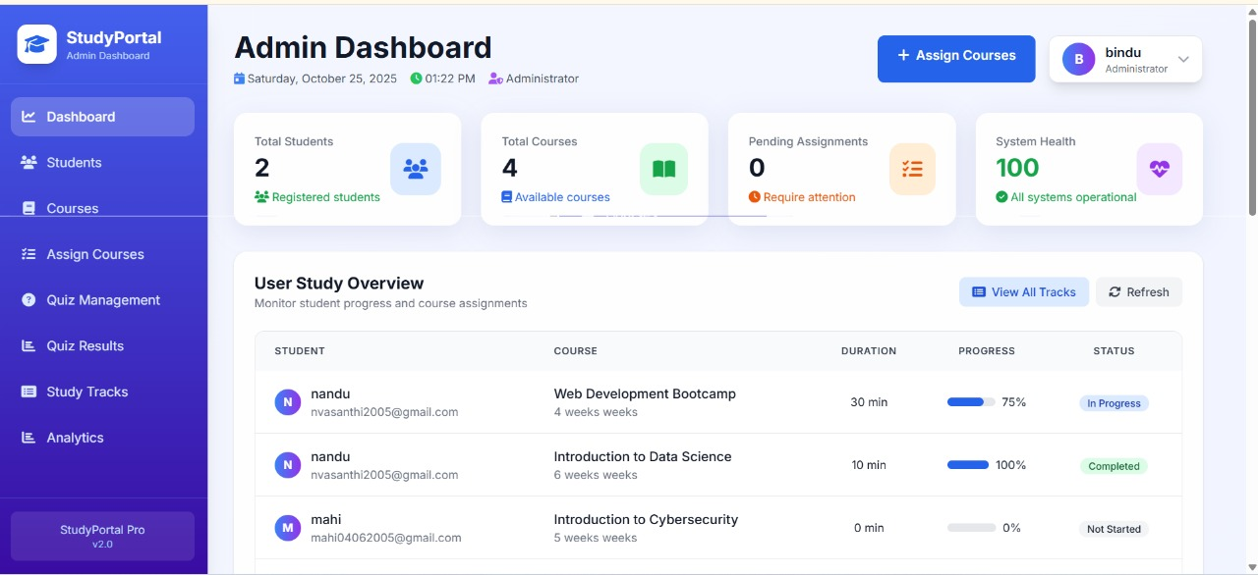
USER DASHBOARD
ADMIN DASHBOARD

Slide 11
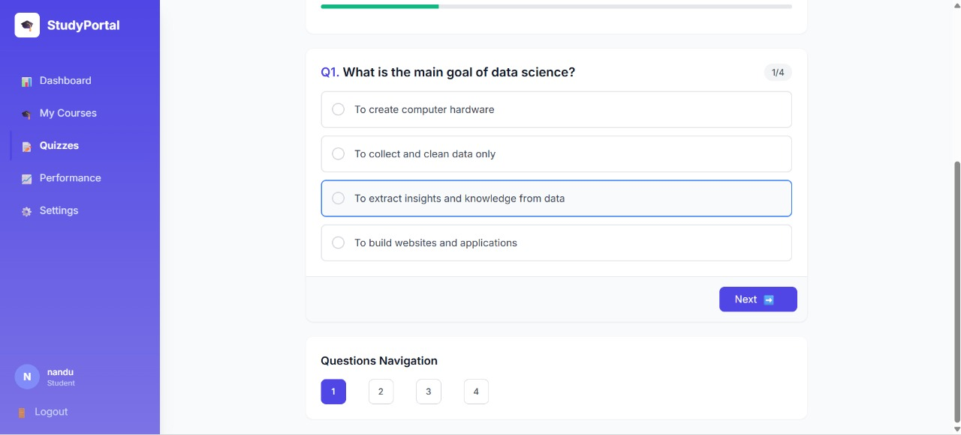
Quiz Platform

Slide 12
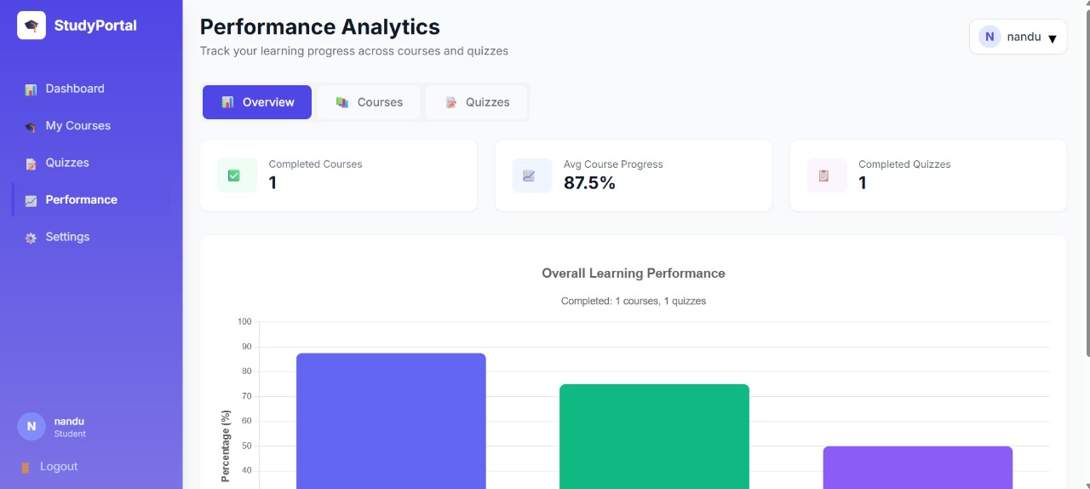
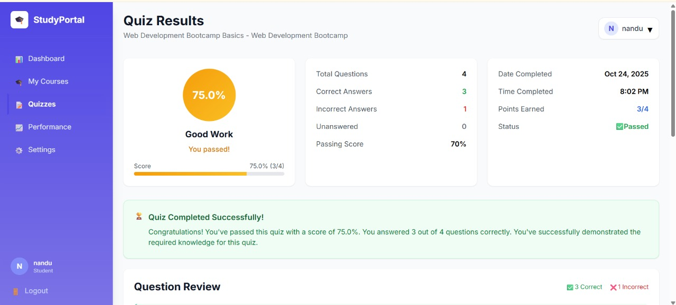
User-Results Dashboard

Slide 13
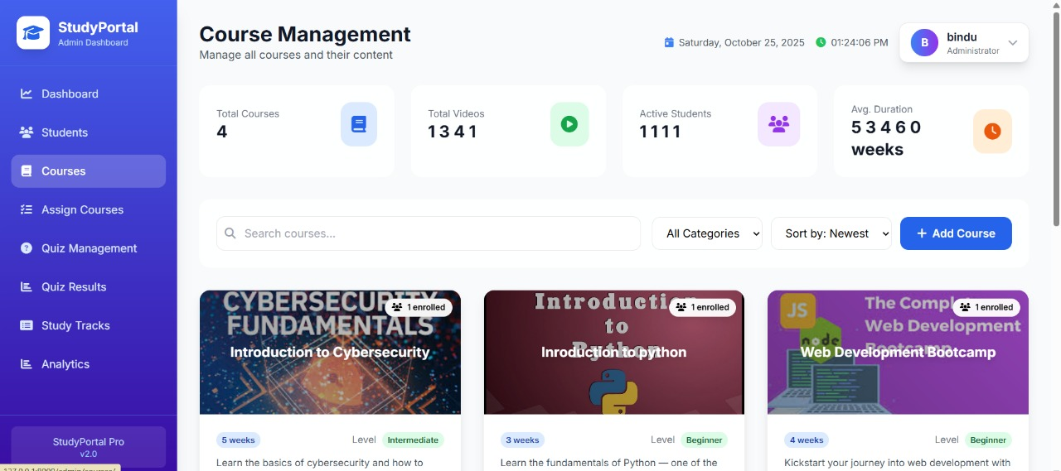
ADMIN DASHBOARD

Slide 14
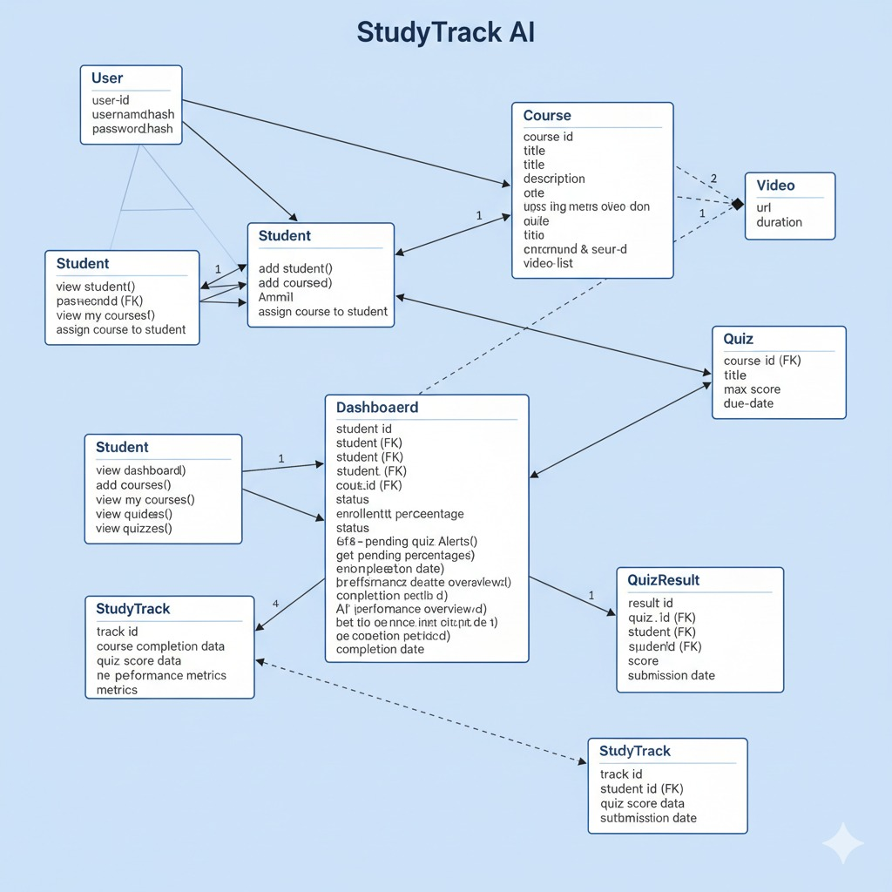
CLASS DIAGRAM

Slide 15


Impacts and Benefits
Enhanced Learning Experience -
Users receive personalized dashboards, progress tracking, and AI-driven recommendations - making learning more engaging, interactive, and tailored to individual needs.
Improved User Management - The admin dashboard enables efficient handling of users — from registration to progress monitoring — improving overall platform organization and control.
Increased User Engagement - Automated notifications and alerts keep learners consistently motivated and remind them to complete courses and quizzes, leading to higher course completion rates.
Data-Driven Insights: The system provides real-time analytics on user performance and progress, helping both students and admins make informed decisions.

Slide 16
CONCLUSION
The Recommending Study Habits project revolutionizes the way students learn by offering a truly personalized approach to education.
By analyzing individual student behavior, our system provides a clear pathway to academic success, empowering students to study smarter, not just harder.
This innovative platform represents the future of data-driven learning, delivering a powerful tool for both students and educators to optimize performance and unlock potential.

Slide 17
TEAM MEMBERS
SRIJA ILAM
MIRYALA NANDU VASANTHI

Slide 18

Thank You

